Slide 1
TAG Parent Meeting
August 19, 2016

Slide 2
TAG Mission Statement
To push students beyond their intellectual comfort zone
To encourage critical and creative thinking
To provide opportunities to become collaborative team members
To assist students in becoming real-world problem solvers and decision makers
To facilitate a sense of confidence through leadership opportunities and public speaking activities
To promote experiences that foster independent thinking and learning

Slide 3
Answers to the Most Frequently asked Questions ?????
Class size is limited to 22
Services are received one day a week using a “pull out” model
Three interdisciplinary units are taught a year connecting to Science and Social Studies. Units last 6 to 8 weeks
A progress report will be issued at the end of each unit. Grades are reported as S, N. NE and U
TAG does not assign homework; some students may choose to work at home
While in TAG general class assignments are not required to be made up however, homework assignments, projects and tests will still be required
Once a student qualifies for TAG they will be offered TAG services each year unless he/she fails to meet the continuation criteria
Students can go “inactive” voluntarily but must remain inactive for 18 weeks before returning
Middle school schedules/ parent meeting

Slide 4
Typical Day in TAG
Class Meeting
Critical/Creative Problem Solving
Unit Work
Reflect and Respond
Specials
Snacks and Water
Recess

Slide 5
Units by grade level
The timeline is subject to change to fit school/county activities, weather make-up days, additional testing, etc…
TAG Lunch Time – 12:00-12:30 Daily
Summit Hill: TAG Units – 2016-2017
 | 1st Grade | 2nd Grade | 3rd Grade | 4th Grade | 5th Grade | Timeline/Dates
Unit 1: Advanced Research and Advanced Communication Skills | Georgia | Georgia | Biomes: Big and Small | Camp Interdependence | Georgia’s Coast | Aug.-Nov. (9 weeks) TAG Testing: Sept. 26-Oct. 7 ITBS: Oct. 24-28 Thanksgiving Break: Nov. 21-25
Unit 2: Higher Order/Critical Thinking and Advanced Communication Skills | Where in the World? | Where in the World? | Our National Treasures | Qualities of Leadership | Epidemic | Dec.-March (9 weeks) Winter Holidays: Dec. 23-Jan. 9 TAG Testing: February
Unit 3: Creative Thinking/Creative Problem Solving and Advanced Communication Skills | Zoo-ology | Zoo-ology | American Footprints | Mind Your Own Business: Toy Company | Pioneers of the 20th Century | March –May (8 weeks) Spring Break: April 3-7 GA Milestones: April 17-May 5

Slide 6
Communication
TAG teachers will be sending home a folder ½ way through each unit so you can see examples of the work your student has completed. All papers must returned back to TAG class and a portfolio will be compiled of all of their work which will be to sent home with your child at the end of the school year. An e-mail will be sent informing you of the timing of these folders because they may not coincide with the blue communication folders sent home by homeroom teachers.
Email is an effective way to communicate with us. We try to check our email during the school day however, school policy is that we have 24 hours to respond.
Please contact the front office if there is an emergency
Email addresses are as follows:
hanger@fultonschools.org
herringtonL@fultonschools.org

Slide 7
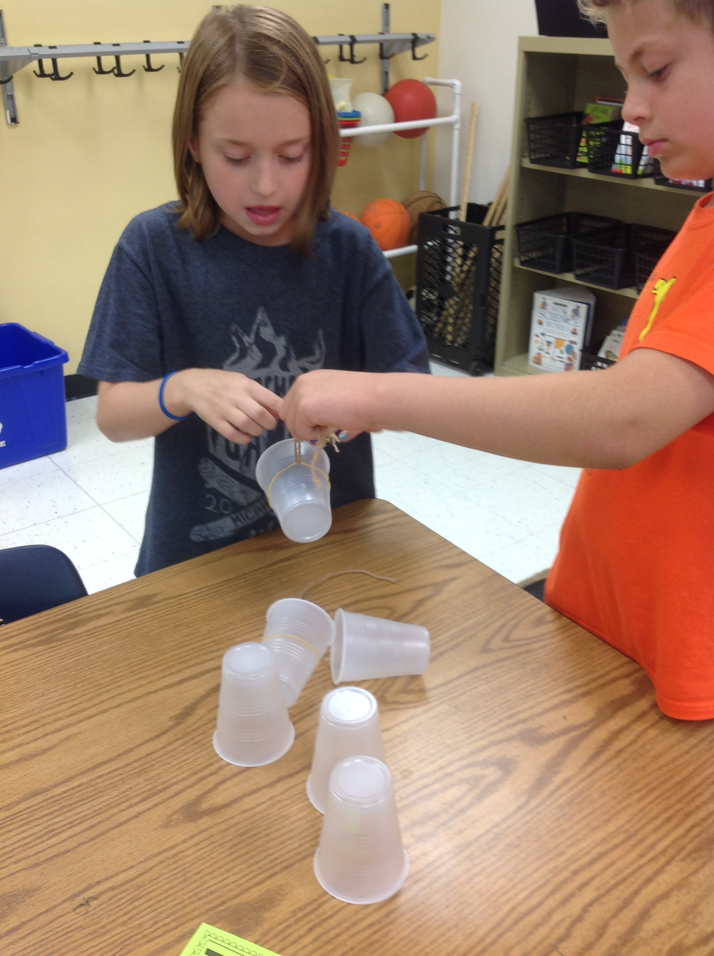
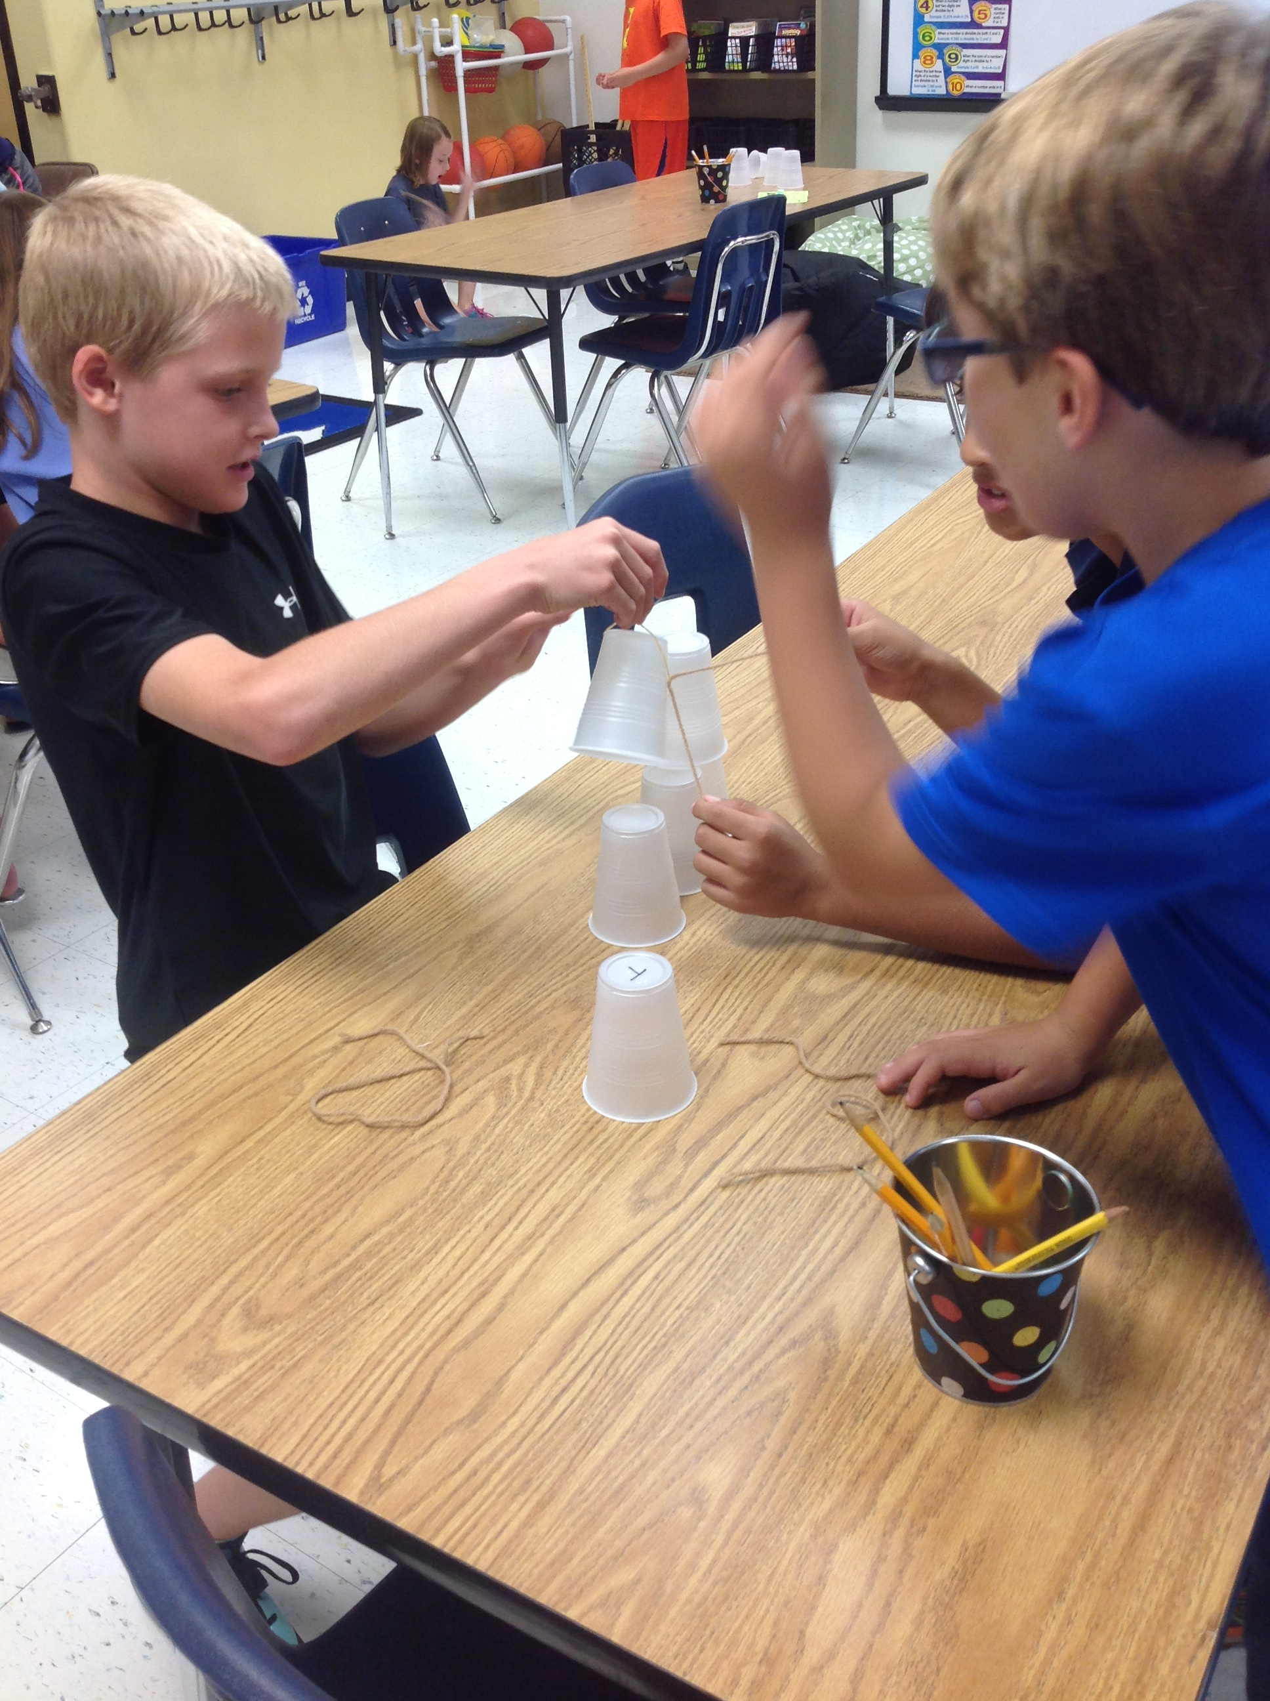
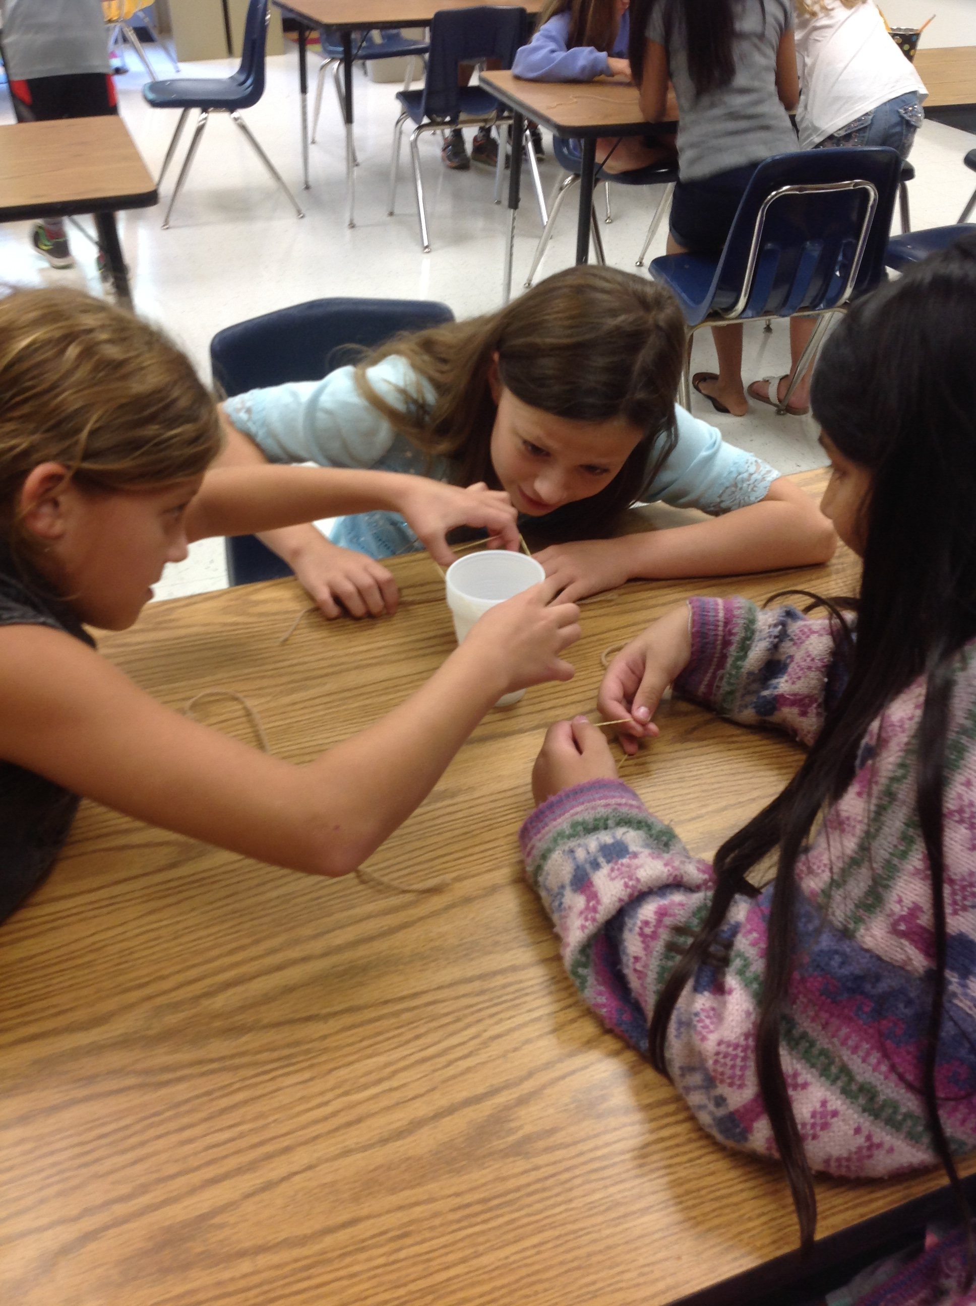
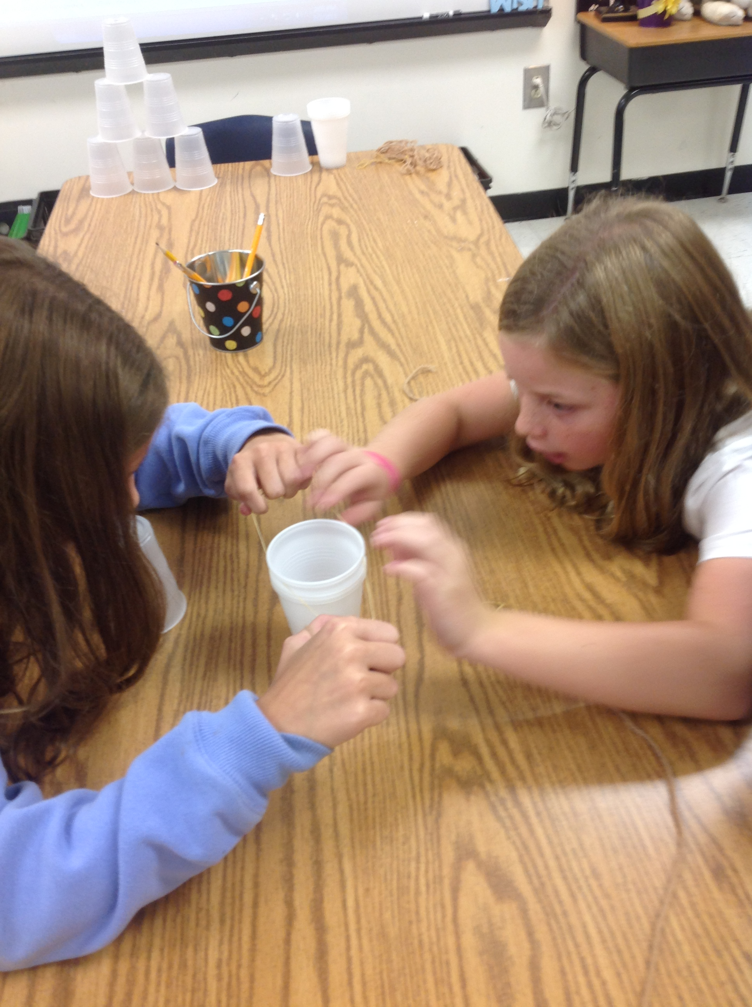
Problem Solving/creative thinking Activity

